Slide 1
LLMs FROM FIRST PRINCIPLES • CLASS 2
DOUGLAS SCHONHOLTZ
From one neuron to next-token prediction
How one parameter learns—and how the same objective scales into language
One prediction. One slope. One update. Then scale.
Notes:
Timing: 0:00–0:02
Purpose: Set the class promise around one understandable object and a cumulative scale-up.
Talk track:
Tell participants that the class will not begin with a transformer diagram. It begins with one neuron making one useful decision. Every later mechanism must be explainable as either the same calculation repeated, a new way to represent context, or software wrapped around the model.
Ask / teaching move:
Ask who has changed a model-backed system without being able to explain which weights or gradients moved.
Transition:
Begin with a concrete routing decision before showing any notation.
[Sources]
- User-provided curriculum direction and course design discussion, August 2026.
[/Sources]

Slide 2
THE CLASS PROMISE
Understand one update before scaling the architecture
If you can explain how one neuron improves, you can explain the learning mechanism inside a transformer.
Attention changes how context is represented. It does not replace prediction, loss, gradients, or updates.
LLMs FROM FIRST PRINCIPLES • CLASS 2
2
Notes:
Timing: 0:02–0:05
Purpose: State the conceptual contract and prevent scale from being mistaken for a new learning algorithm.
Talk track:
The central claim is intentionally narrow. A transformer contains more than repeated neurons: attention, residual paths, normalization, and position matter. But its trainable parameters still change through the same loss-gradient-update loop we can see in one neuron.
Transition:
Show the ladder the class will climb.
[Sources]
- User-provided curriculum direction and course design discussion, August 2026.
- Ian Goodfellow, Yoshua Bengio, and Aaron Courville, Deep Learning — https://www.deeplearningbook.org/
- Ashish Vaswani et al., Attention Is All You Need — https://arxiv.org/abs/1706.03762
[/Sources]

Slide 3
THE LEARNING LADDER
The prediction job stays recognizable as the representation improves
ONE NEURON
One yes/no score
OUTPUT LAYER
One score per class
N-GRAM LM
Next token from fixed context
TRANSFORMER
Next token from learned context
→
→
→
Scale changes the number of parameters and the quality of context—not the need for an objective and a gradient.
LLMs FROM FIRST PRINCIPLES • CLASS 2
3
Notes:
Timing: 0:05–0:08
Purpose: Provide the organizing map for all three hours.
Talk track:
Read left to right. One neuron scores one binary class. An output layer scores several classes. An n-gram language model treats the next token as a class using fixed context. A transformer keeps that class objective and builds a richer context-dependent representation.
Ask / teaching move:
Ask which transition currently feels like the largest conceptual jump.
Transition:
Translate the map into a timed run of show.
[Sources]
- User-provided curriculum direction and course design discussion, August 2026.
- Daniel Jurafsky and James H. Martin, Speech and Language Processing, 3rd edition draft — https://web.stanford.edu/~jurafsky/slp3/
- Ashish Vaswani et al., Attention Is All You Need — https://arxiv.org/abs/1706.03762
[/Sources]

Slide 4
THREE HOURS
Build, teach, and scale one model
01 DECIDE
One label
02 PREDICT
One neuron
03 LEARN
One update
04 BATCH
Many examples
05 LANGUAGE
Next token
06 BRIDGE
Transformer
Time | Question | Learner action
0:00–0:45 | How can one neuron classify? | Trace a complete forward pass
0:45–1:20 | Why does the derivative matter? | Navigate one loss curve
1:30–2:00 | Can ordinary Python reproduce it? | Implement and check one update
2:00–2:25 | What changes when we scale? | Debug batches and multiclass shapes
2:35–3:00 | How does classification become language? | Build an n-gram and expose its limit
LLMs FROM FIRST PRINCIPLES • CLASS 2
4
Notes:
Timing: 0:08–0:12
Purpose: Give the room a cognitive map and establish the breaks.
Talk track:
Name the two breaks at 1:20 and 2:25. Emphasize that the final section is not a compressed transformer lecture. It creates the exact problem Class 3 will solve.
Transition:
Ask for the first binary decision.
[Sources]
- User-provided curriculum direction and course design discussion, August 2026.
[/Sources]

Slide 5
COLD CLASSIFICATION
Should this ticket go to security?
01 DECIDE
One label
02 PREDICT
One neuron
03 LEARN
One update
04 BATCH
Many examples
05 LANGUAGE
Next token
06 BRIDGE
Transformer
“A contractor pasted an API key into a public issue and attempted to change repository permissions.”
Should BugBoard route this ticket to security?
Commit first: YES / NO / NOT ENOUGH INFORMATION
LLMs FROM FIRST PRINCIPLES • CLASS 2
5
Notes:
Timing: 0:12–0:18
Purpose: Make classification feel like a useful product decision before introducing a model.
Talk track:
Read the fictional ticket and force a commitment. Participants already possess an informal decision function. The neuron will make that function explicit and adjustable.
Ask / teaching move:
What observable facts in the ticket changed your decision?
Transition:
Turn those observations into numeric inputs.
[Sources]
- Course-created fictional BugBoard examples and numerical values; not production or WHOOP data.
[/Sources]

Slide 6
INPUTS ARE MEASUREMENTS
Features make the decision inspectable
01 DECIDE
One label
02 PREDICT
One neuron
03 LEARN
One update
04 BATCH
Many examples
05 LANGUAGE
Next token
06 BRIDGE
Transformer
x₁ · credentials
x₂ · unauthorized action
y · security label
1 when the ticket mentions a key, secret, password, or credential.
0 otherwise.
1 when the ticket describes an unapproved permission or account change.
0 otherwise.
1 when the reviewed training label says security routing is correct.
0 otherwise.
LLMs FROM FIRST PRINCIPLES • CLASS 2
6
Notes:
Timing: 0:18–0:24
Purpose: Separate the observable input contract from the learned parameters.
Talk track:
These features are deliberately simple and handcrafted. That is a teaching choice, not a claim about production feature engineering. The label is also a reviewed decision, not a fact emitted by the model.
Ask / teaching move:
Name one useful signal this two-feature model cannot represent.
Transition:
Let one neuron combine the measurements.
[Sources]
- Course-created fictional BugBoard examples and numerical values; not production or WHOOP data.
- Ian Goodfellow, Yoshua Bengio, and Aaron Courville, Deep Learning — https://www.deeplearningbook.org/
[/Sources]

Slide 7
ONE COMPUTATIONAL UNIT
A neuron turns evidence into a score
01 DECIDE
One label
02 PREDICT
One neuron
03 LEARN
One update
04 BATCH
Many examples
05 LANGUAGE
Next token
06 BRIDGE
Transformer
ONE NEURON
z = w₁x₁ + w₂x₂ + b
p = sigmoid(z)
INPUTS
x₁ credentials
x₂ unauthorized action
OUTPUT
Probability of security routing
Threshold → product action
→
→
The model parameters are the weights and bias. The threshold belongs to the product decision.
LLMs FROM FIRST PRINCIPLES • CLASS 2
7
Notes:
Timing: 0:24–0:30
Purpose: Install the anatomy of the single neuron.
Talk track:
The weighted sum says how strongly the current evidence supports security routing. The bias is the score before either feature contributes. Sigmoid turns the unbounded score into a number between zero and one. The threshold converts probability into an action.
Transition:
Put real numbers through every part.
[Sources]
- Ian Goodfellow, Yoshua Bengio, and Aaron Courville, Deep Learning — https://www.deeplearningbook.org/
- Course-created fictional BugBoard examples and numerical values; not production or WHOOP data.
[/Sources]

Slide 8
FORWARD PASS
Every number has one job
01 DECIDE
One label
02 PREDICT
One neuron
03 LEARN
One update
04 BATCH
Many examples
05 LANGUAGE
Next token
06 BRIDGE
Transformer
Quantity | Value | Meaning
x | [1, 0] | Credentials present; unauthorized action absent
w | [1.2, 0.7] | How much each feature contributes
b | −0.5 | Default score before the features
z | 0.7 | 1×1.2 + 0×0.7 − 0.5
p | 0.668 | sigmoid(0.7)
At a 0.50 threshold, BugBoard routes the ticket to security.
LLMs FROM FIRST PRINCIPLES • CLASS 2
8
Notes:
Timing: 0:30–0:38
Purpose: Complete one forward pass using numbers small enough to audit aloud.
Talk track:
Have the room calculate the logit before revealing it. Then convert the score with sigmoid. Keep probability and policy distinct: 0.668 is the model output; security routing at 0.50 is the application decision.
Ask / teaching move:
Which number would you change to make the neuron more cautious without retraining it?
Transition:
Make the score-to-probability mapping visible.
[Sources]
- Course-created fictional BugBoard examples and numerical values; not production or WHOOP data.
- Ian Goodfellow, Yoshua Bengio, and Aaron Courville, Deep Learning — https://www.deeplearningbook.org/
[/Sources]

Slide 9
SCORE → PROBABILITY
Sigmoid preserves ordering and compresses the score
01 DECIDE
One label
02 PREDICT
One neuron
03 LEARN
One update
04 BATCH
Many examples
05 LANGUAGE
Next token
06 BRIDGE
Transformer
p = 1 / (1 + exp(−z))
Large negative scores approach 0. A score of 0 becomes 0.5. Large positive scores approach 1.
LLMs FROM FIRST PRINCIPLES • CLASS 2
9
Notes:
Timing: 0:38–0:45
Purpose: Give the output probability a concrete mathematical origin.
Talk track:
Do not call sigmoid confidence calibration. It is the function used to parameterize a Bernoulli probability. Whether the probability is calibrated must be tested on held-out evidence.
Ask / teaching move:
What probability must every z = 0 produce?
Transition:
Separate what the model predicts from what the product decides.
[Sources]
- Ian Goodfellow, Yoshua Bengio, and Aaron Courville, Deep Learning — https://www.deeplearningbook.org/
[/Sources]

Slide 10
MODEL VS PRODUCT
Changing the threshold does not teach the neuron
01 DECIDE
One label
02 PREDICT
One neuron
03 LEARN
One update
04 BATCH
Many examples
05 LANGUAGE
Next token
06 BRIDGE
Transformer
Change a weight
Change the bias
Change the threshold
Changes the probability produced by the model for affected examples.
Requires a parameter edit or training.
Moves the model’s default tendency across every example.
Still changes the model.
Changes which probabilities trigger the product action.
The model output is unchanged.
LLMs FROM FIRST PRINCIPLES • CLASS 2
10
Notes:
Timing: 0:45–0:50
Purpose: Prevent deployment policy from being confused with learned behavior.
Talk track:
This distinction matters in production. Teams can often change escalation thresholds faster and more safely than model weights. But threshold changes trade false positives against false negatives; they do not improve the probability estimates.
Transition:
A prediction alone does not tell training how to improve.
[Sources]
- User-provided curriculum direction and course design discussion, August 2026.
- Ian Goodfellow, Yoshua Bengio, and Aaron Courville, Deep Learning — https://www.deeplearningbook.org/
[/Sources]

Slide 11
THE TRAINING PROBLEM
A prediction is not yet an objective
Training needs one number that says how undesirable the current parameters are.
That number is the loss. The complete loss function tells us how every possible parameter choice would score.
LLMs FROM FIRST PRINCIPLES • CLASS 2
11
Notes:
Timing: 0:50–0:54
Purpose: Create the need for loss before presenting its formula.
Talk track:
Correct versus incorrect is too coarse for optimization. A 0.49 prediction and a 0.01 prediction may both miss a positive label, but the second assigns far less probability to the observed outcome.
Transition:
Define the penalty used by binary classification.
[Sources]
- Ian Goodfellow, Yoshua Bengio, and Aaron Courville, Deep Learning — https://www.deeplearningbook.org/
[/Sources]

Slide 12
BINARY CROSS-ENTROPY
Confident mistakes receive the largest penalty
01 DECIDE
One label
02 PREDICT
One neuron
03 LEARN
One update
04 BATCH
Many examples
05 LANGUAGE
Next token
06 BRIDGE
Transformer
L = −[y log(p) + (1−y) log(1−p)]
For a positive label, loss is −log(p). Assigning less probability to the observed label raises the penalty rapidly.
LLMs FROM FIRST PRINCIPLES • CLASS 2
12
Notes:
Timing: 0:54–1:02
Purpose: Connect probability assignment to a scalar training objective.
Talk track:
Read the formula by label. When y equals one, only the first term remains. When y equals zero, only the second term remains. The loss is not product quality; it is a differentiable training signal for this prediction task.
Ask / teaching move:
Which has higher loss for y = 1: p = 0.55 or p = 0.10? Why?
Transition:
Evaluate the objective across possible weight values.
[Sources]
- Ian Goodfellow, Yoshua Bengio, and Aaron Courville, Deep Learning — https://www.deeplearningbook.org/
[/Sources]

Slide 13
RANK THE MISTAKES
The loss contains more information than correct / incorrect
01 DECIDE
One label
02 PREDICT
One neuron
03 LEARN
One update
04 BATCH
Many examples
05 LANGUAGE
Next token
06 BRIDGE
Transformer
Correct label | Predicted p(y=1) | Interpretation | Relative penalty
1 | 0.90 | Correct and high probability | Low
1 | 0.55 | Correct side of threshold; uncertain | Moderate
1 | 0.10 | Wrong and confident | Very high
0 | 0.80 | Wrong and confident | High
Optimization follows the continuous penalty—not the thresholded product action.
LLMs FROM FIRST PRINCIPLES • CLASS 2
13
Notes:
Timing: 1:02–1:06
Purpose: Make the loss ordering intuitive before introducing the derivative.
Talk track:
Ask learners to rank the rows before showing the last column. This is why training uses the probability and target, not the deployed threshold.
Transition:
Plot the same objective as one weight changes.
[Sources]
- Ian Goodfellow, Yoshua Bengio, and Aaron Courville, Deep Learning — https://www.deeplearningbook.org/
[/Sources]

Slide 14
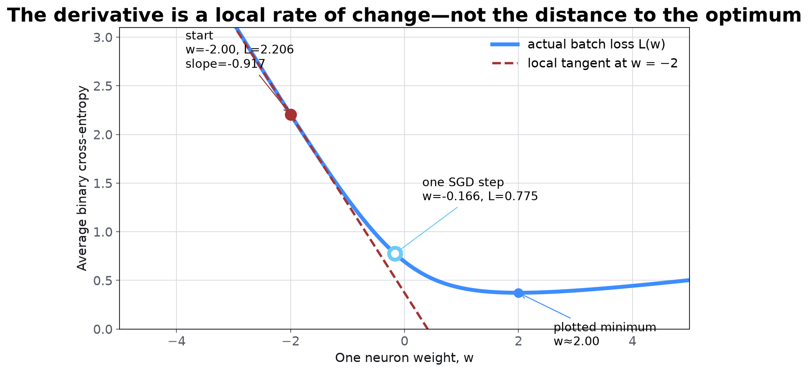
THE COMPLETE OBJECTIVE
The curve shows where this weight performs best
01 DECIDE
One label
02 PREDICT
One neuron
03 LEARN
One update
04 BATCH
Many examples
05 LANGUAGE
Next token
06 BRIDGE
Transformer
Python recomputes L: 2.206 → 0.775 after w: -2.00 → -0.166.
LLMs FROM FIRST PRINCIPLES • CLASS 2
14
Notes:
Timing: 1:06–1:11
Purpose: Make the relationship between current parameters and the minimum visually explicit.
Talk track:
The blue curve is the average binary cross-entropy over six fictional labeled tickets as one weight varies and other parameters stay fixed. The minimum is the best plotted value for this restricted problem. Training does not receive the minimum directly; it can measure only local change at the current point.
Transition:
Name that local rate of change precisely.
[Sources]
- Course-created fictional BugBoard examples and numerical values; not production or WHOOP data.
- Ian Goodfellow, Yoshua Bengio, and Aaron Courville, Deep Learning — https://www.deeplearningbook.org/
[/Sources]

Slide 15
THE DERIVATIVE
The derivative is the local rate at which loss changes
01 DECIDE
One label
02 PREDICT
One neuron
03 LEARN
One update
04 BATCH
Many examples
05 LANGUAGE
Next token
06 BRIDGE
Transformer
dL/dw = local slope of the loss curve
Sign gives the locally improving direction. Magnitude gives local sensitivity. It does not directly report the distance to the optimum.
LLMs FROM FIRST PRINCIPLES • CLASS 2
15
Notes:
Timing: 1:11–1:15
Purpose: Correct the common shortcut that treats a gradient as merely an arrow toward the answer.
Talk track:
At the current weight, imagine a tangent touching the loss curve. A negative slope means increasing the weight lowers loss locally. A positive slope means decreasing it lowers loss. A near-zero slope means the curve is locally flat, which may be a minimum, maximum, or saddle point in larger problems.
Ask / teaching move:
If dL/dw is positive, should gradient descent increase or decrease w?
Transition:
Turn the slope into an update rule.
[Sources]
- Ian Goodfellow, Yoshua Bengio, and Aaron Courville, Deep Learning — https://www.deeplearningbook.org/
[/Sources]

Slide 16
GRADIENT DESCENT
Move against the direction in which loss increases
01 DECIDE
One label
02 PREDICT
One neuron
03 LEARN
One update
04 BATCH
Many examples
05 LANGUAGE
Next token
06 BRIDGE
Transformer
w_next = w − η · dL/dw
The derivative chooses direction; the learning rate η chooses step size. After the step, recompute the real loss rather than trusting the tangent forever.
LLMs FROM FIRST PRINCIPLES • CLASS 2
16
Notes:
Timing: 1:15–1:18
Purpose: Make the minus sign and learning-rate role causally understandable.
Talk track:
The tangent is a local approximation. A small step often follows it well. A large step can cross the minimum, land on a steeper region, or increase the actual loss.
Transition:
Show why step size must be treated as an engineering parameter.
[Sources]
- Ian Goodfellow, Yoshua Bengio, and Aaron Courville, Deep Learning — https://www.deeplearningbook.org/
[/Sources]

Slide 17
STEP SIZE
The same derivative can produce three very different updates
01 DECIDE
One label
02 PREDICT
One neuron
03 LEARN
One update
04 BATCH
Many examples
05 LANGUAGE
Next token
06 BRIDGE
Transformer
Too small
Useful
Too large
Loss usually falls, but progress is slow and training may consume unnecessary compute.
The step is large enough to move while remaining consistent with the local slope.
The update can overshoot the minimum, oscillate, or make the loss diverge.
LLMs FROM FIRST PRINCIPLES • CLASS 2
17
Notes:
Timing: 1:18–1:20
Purpose: Connect the geometric picture to learning-rate behavior.
Talk track:
The learning rate converts a derivative into an actual parameter change. Optimizers add machinery, but none can remove the need to control step size and inspect training behavior.
Transition:
After the break, compute where the derivative comes from.
[Sources]
- Ian Goodfellow, Yoshua Bengio, and Aaron Courville, Deep Learning — https://www.deeplearningbook.org/
[/Sources]

Slide 18
BACKPROPAGATION
Chain local rates of change through the neuron
01 DECIDE
One label
02 PREDICT
One neuron
03 LEARN
One update
04 BATCH
Many examples
05 LANGUAGE
Next token
06 BRIDGE
Transformer
dL/dw = (dL/dp) · (dp/dz) · (dz/dw)
Loss changes with probability; probability changes with score; score changes with the weight. Multiply those local sensitivities to get the parameter’s effect on loss.
LLMs FROM FIRST PRINCIPLES • CLASS 2
18
Notes:
Timing: 1:20
Purpose: Preview backpropagation as compositional rate-of-change accounting.
Talk track:
This is the key scaling idea. A large network contains many more paths, but automatic differentiation applies the same local chain rule. Each parameter receives a gradient describing how a small change would affect the final objective through every relevant path.
Transition:
Take the first break, then calculate the complete update.
[Sources]
- Ian Goodfellow, Yoshua Bengio, and Aaron Courville, Deep Learning — https://www.deeplearningbook.org/
- PyTorch, A Gentle Introduction to torch.autograd — https://docs.pytorch.org/tutorials/beginner/blitz/autograd_tutorial.html
[/Sources]

Slide 19
1:20–1:30
Next: compute one complete update
Return at 1:30 with the loss curve and chain rule still visible.
LLMs FROM FIRST PRINCIPLES • CLASS 2
19
Notes:
Timing: 1:20–1:30
Purpose: Provide a reset before the hand calculation and code lab.
Talk track:
During the break, open the forward-pass and loss modules. Confirm that the sliders, plot, and gradient-step button respond.
Transition:
Restart with the derivative simplification for sigmoid plus binary cross-entropy.
[Sources]
- User-provided curriculum direction and course design discussion, August 2026.
[/Sources]

Slide 20
THE USEFUL SIMPLIFICATION
For sigmoid plus cross-entropy, the score derivative becomes prediction minus label
01 DECIDE
One label
02 PREDICT
One neuron
03 LEARN
One update
04 BATCH
Many examples
05 LANGUAGE
Next token
06 BRIDGE
Transformer
dL/dz = p − y
The sign says whether the score is too high or too low. The magnitude says how far the probability is from the observed binary label.
LLMs FROM FIRST PRINCIPLES • CLASS 2
20
Notes:
Timing: 1:30–1:35
Purpose: Give learners the compact derivative used in the full update.
Talk track:
Do not present this as a formula to memorize without context. It is the result of multiplying the cross-entropy and sigmoid derivatives. Its interpretation is unusually direct: prediction minus target.
Ask / teaching move:
For y = 1 and p = 0.668, should the score rise or fall?
Transition:
Propagate the score error into each parameter.
[Sources]
- Ian Goodfellow, Yoshua Bengio, and Aaron Courville, Deep Learning — https://www.deeplearningbook.org/
[/Sources]

Slide 21
ONE TRAINING STEP
The gradient assigns credit or blame to each parameter
01 DECIDE
One label
02 PREDICT
One neuron
03 LEARN
One update
04 BATCH
Many examples
05 LANGUAGE
Next token
06 BRIDGE
Transformer
Quantity | Calculation | Result
Score error | dz = p − y | −0.332
Weight 1 gradient | dw₁ = dz · x₁ | −0.332
Weight 2 gradient | dw₂ = dz · x₂ | 0.000
Bias gradient | db = dz | −0.332
Update, η = 0.1 | parameter − η · gradient | w₁ and b rise
x₂ was absent, so this example supplies no evidence about w₂.
LLMs FROM FIRST PRINCIPLES • CLASS 2
21
Notes:
Timing: 1:35–1:42
Purpose: Calculate every gradient and connect it to the active input features.
Talk track:
The example is positive but the prediction is below one, so dz is negative. Subtracting a negative gradient raises w1 and the bias. Because x2 equals zero, its weight receives no gradient from this example.
Transition:
Recompute the prediction after the update.
[Sources]
- Course-created fictional BugBoard examples and numerical values; not production or WHOOP data.
- Ian Goodfellow, Yoshua Bengio, and Aaron Courville, Deep Learning — https://www.deeplearningbook.org/
[/Sources]

Slide 22
VERIFY THE CONSEQUENCE
A useful update improves the actual objective
01 DECIDE
One label
02 PREDICT
One neuron
03 LEARN
One update
04 BATCH
Many examples
05 LANGUAGE
Next token
06 BRIDGE
Transformer
 | Before | After one step
w₁ | 1.200 | 1.233
b | −0.500 | −0.467
z | 0.700 | 0.766
p(y=1) | 0.668 | 0.683
Loss | 0.403 | 0.381
The derivative predicted a locally improving direction; the recomputed loss confirms it.
LLMs FROM FIRST PRINCIPLES • CLASS 2
22
Notes:
Timing: 1:42–1:48
Purpose: Close the hand calculation by verifying the prediction and loss after the update.
Talk track:
The gradient is not proof that any arbitrary step will help. We took a bounded step, reran the forward pass, and measured the actual objective. That verification habit carries into real training curves and evaluation gates.
Transition:
Implement the same trace in ordinary Python.
[Sources]
- Course-created fictional BugBoard examples and numerical values; not production or WHOOP data.
- Ian Goodfellow, Yoshua Bengio, and Aaron Courville, Deep Learning — https://www.deeplearningbook.org/
[/Sources]

Slide 23
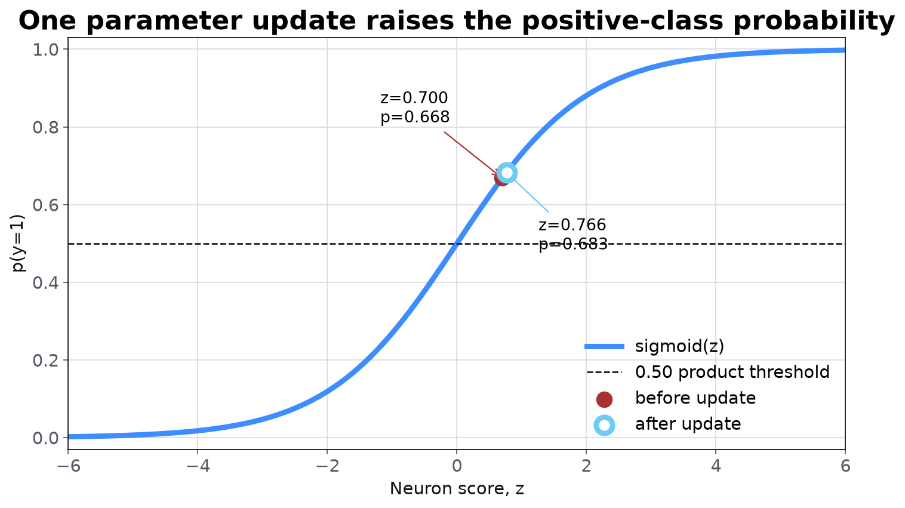
EXECUTABLE WORKED EXAMPLE
Python reproduces the complete hand calculation
01 DECIDE
One label
02 PREDICT
One neuron
03 LEARN
One update
04 BATCH
Many examples
05 LANGUAGE
Next token
06 BRIDGE
Transformer
One ticket, one neuron, one auditable update.
z = 0.700
p = 0.668
loss = 0.403
dL/dz = -0.332
w₁: 1.200 → 1.233
b: -0.500 → -0.467
loss: 0.403 → 0.382
Run 01_single_neuron.py, then change one input and predict which gradients become zero.
LLMs FROM FIRST PRINCIPLES • CLASS 2
23
Notes:
Timing: 1:48–1:51
Purpose: Prove that the hand calculation and executable implementation are the same trace.
Talk track:
Run the script and read the terminal output top to bottom. The chart shows that the parameter update raises the positive-class probability, while the printed trace confirms that the actual cross-entropy fell.
Ask / teaching move:
If x2 changes from zero to one, which previously zero gradient becomes active?
Transition:
Expose the small NumPy statements that produced the trace.
[Sources]
- Course-created fictional BugBoard examples and numerical values; not production or WHOOP data.
- Ian Goodfellow, Yoshua Bengio, and Aaron Courville, Deep Learning — https://www.deeplearningbook.org/
[/Sources]

Slide 24
NUMPY LAB
Each function corresponds to one concept
01 DECIDE
One label
02 PREDICT
One neuron
03 LEARN
One update
04 BATCH
Many examples
05 LANGUAGE
Next token
06 BRIDGE
Transformer
z = x @ w + b
p = 1 / (1 + np.exp(-z))
loss = -(y*np.log(p) + (1-y)*np.log(1-p))
dz = p - y
dw, db = dz * x, dz
w, b = w - learning_rate*dw, b - learning_rate*db
01_single_neuron.py prints this exact trace and writes the slide chart.
LLMs FROM FIRST PRINCIPLES • CLASS 2
24
Notes:
Timing: 1:51–1:56
Purpose: Translate the conceptual sequence into a small executable implementation.
Talk track:
These statements are the complete training step for the example, not pseudocode with hidden framework behavior. Students should assert the printed values before changing the fixture.
Transition:
Add an independent numerical check on the derivative.
[Sources]
- User-provided curriculum direction and course design discussion, August 2026.
- Ian Goodfellow, Yoshua Bengio, and Aaron Courville, Deep Learning — https://www.deeplearningbook.org/
[/Sources]

Slide 25
GRADIENT CHECK
Finite differences test the derivative without trusting the derivation
01 DECIDE
One label
02 PREDICT
One neuron
03 LEARN
One update
04 BATCH
Many examples
05 LANGUAGE
Next token
06 BRIDGE
Transformer
dL/dw ≈ [L(w + ε) − L(w − ε)] / (2ε)
Analytical and numerical gradients should agree within a tolerance. Large disagreement usually reveals a derivative, indexing, reduction, or mutation bug.
LLMs FROM FIRST PRINCIPLES • CLASS 2
25
Notes:
Timing: 1:56–2:00
Purpose: Give software engineers a familiar test oracle for gradient code.
Talk track:
A gradient check is slow and numerically approximate, so it is a development test—not the training algorithm. Use a small epsilon, double precision when possible, and tiny deterministic fixtures.
Ask / teaching move:
What would a gradient check catch that a falling training loss might hide?
Transition:
Scale the exact calculation from one example to a matrix.
[Sources]
- Ian Goodfellow, Yoshua Bengio, and Aaron Courville, Deep Learning — https://www.deeplearningbook.org/
- PyTorch, A Gentle Introduction to torch.autograd — https://docs.pytorch.org/tutorials/beginner/blitz/autograd_tutorial.html
[/Sources]

Slide 26
ONE EXAMPLE → BATCH
Matrix multiplication performs many neuron calculations together
01 DECIDE
One label
02 PREDICT
One neuron
03 LEARN
One update
04 BATCH
Many examples
05 LANGUAGE
Next token
06 BRIDGE
Transformer
Z = XW + b
X holds examples by row. W holds learned feature-to-output weights. Broadcasting adds one bias vector to every row.
LLMs FROM FIRST PRINCIPLES • CLASS 2
26
Notes:
Timing: 2:00–2:06
Purpose: Introduce vectorization as repeated familiar work rather than opaque tensor algebra.
Talk track:
The scalar formula has not disappeared. Each cell in Z is still a weighted sum. The matrix notation makes the repeated structure explicit and lets numerical libraries execute it efficiently.
Transition:
Make the shape contract executable.
[Sources]
- Ian Goodfellow, Yoshua Bengio, and Aaron Courville, Deep Learning — https://www.deeplearningbook.org/
[/Sources]

Slide 27
SHAPE CONTRACT
Every dimension has a semantic meaning
01 DECIDE
One label
02 PREDICT
One neuron
03 LEARN
One update
04 BATCH
Many examples
05 LANGUAGE
Next token
06 BRIDGE
Transformer
Tensor | Shape | Meaning
X | [batch, features] | One row per ticket
W | [features, classes] | One column of output weights per class
b | [classes] | One bias per output class
Z | [batch, classes] | One class score per example
y | [batch] | One correct class index per example
LLMs FROM FIRST PRINCIPLES • CLASS 2
27
Notes:
Timing: 2:06–2:10
Purpose: Make tensor debugging a semantic exercise rather than dimension memorization.
Talk track:
Ask learners to narrate each axis in words. A shape can be numerically compatible and still semantically wrong if examples, positions, heads, or classes occupy the wrong axis.
Transition:
Show the bugs introduced by reductions and stateful gradients.
[Sources]
- Ian Goodfellow, Yoshua Bengio, and Aaron Courville, Deep Learning — https://www.deeplearningbook.org/
[/Sources]

Slide 28
COMMON TRAINING BUGS
The reduction rule changes the effective update
01 DECIDE
One label
02 PREDICT
One neuron
03 LEARN
One update
04 BATCH
Many examples
05 LANGUAGE
Next token
06 BRIDGE
Transformer
Sum instead of mean
Average twice
Forget to clear
The update grows with batch size. Changing batch size silently changes the effective learning rate.
Gradients shrink by an extra factor of the batch size and learning slows unexpectedly.
The next optimizer step includes stale evidence from earlier batches.
LLMs FROM FIRST PRINCIPLES • CLASS 2
28
Notes:
Timing: 2:10–2:14
Purpose: Connect batch implementation details to observable training failures.
Talk track:
These are ordinary software bugs with mathematical consequences. Logging the loss reduction, gradient norm, batch size, and optimizer step makes them easier to localize.
Transition:
Use the same batch machinery to produce several class scores.
[Sources]
- User-provided curriculum direction and course design discussion, August 2026.
- PyTorch, A Gentle Introduction to torch.autograd — https://docs.pytorch.org/tutorials/beginner/blitz/autograd_tutorial.html
[/Sources]

Slide 29
ONE OUTPUT → MANY
Multiclass classification is a layer of competing output neurons
01 DECIDE
One label
02 PREDICT
One neuron
03 LEARN
One update
04 BATCH
Many examples
05 LANGUAGE
Next token
06 BRIDGE
Transformer
INPUT
ticket features
SECURITY
score z₁
BILLING
score z₂
PRODUCT
score z₃
SOFTMAX
probabilities
→
→
→
→
Each class receives a logit. Softmax turns the vector into one normalized distribution.
LLMs FROM FIRST PRINCIPLES • CLASS 2
29
Notes:
Timing: 2:14–2:20
Purpose: Generalize one binary neuron into a multiclass output layer.
Talk track:
The output neurons share the same input representation but have different weights and biases. Their logits compete under softmax. This is the structure that will later score every vocabulary token.
Transition:
Make stable softmax and multiclass loss concrete.
[Sources]
- Ian Goodfellow, Yoshua Bengio, and Aaron Courville, Deep Learning — https://www.deeplearningbook.org/
[/Sources]

Slide 30
STABLE SOFTMAX
Subtract the largest logit without changing the probabilities
01 DECIDE
One label
02 PREDICT
One neuron
03 LEARN
One update
04 BATCH
Many examples
05 LANGUAGE
Next token
06 BRIDGE
Transformer
softmax(z)i = exp(zi − max(z)) / Σj exp(zj − max(z))
The shift prevents avoidable overflow. Multiclass cross-entropy penalizes the negative log-probability assigned to the correct class.
LLMs FROM FIRST PRINCIPLES • CLASS 2
30
Notes:
Timing: 2:20–2:22
Purpose: Connect numerical stability to the multiclass output layer.
Talk track:
Softmax is invariant to adding or subtracting the same constant from every logit. Subtracting the maximum keeps the largest exponent at one and the others at or below one.
Ask / teaching move:
What changes if every logit increases by 100?
Transition:
Run the three-class calculation with actual logits.
[Sources]
- Ian Goodfellow, Yoshua Bengio, and Aaron Courville, Deep Learning — https://www.deeplearningbook.org/
[/Sources]

Slide 31
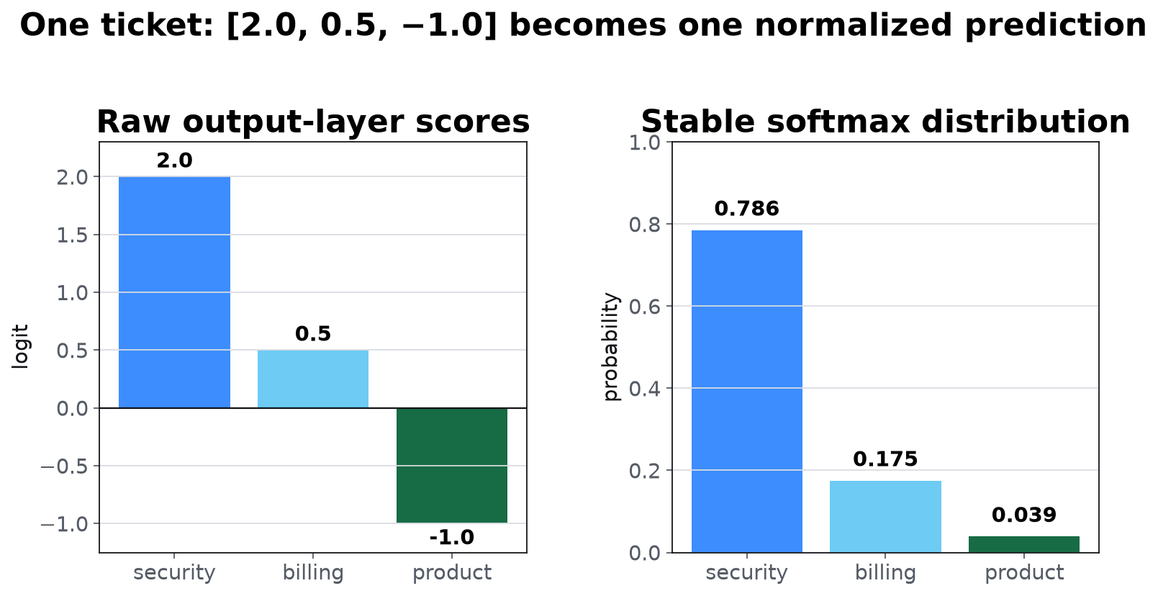
EXECUTABLE WORKED EXAMPLE
Three logits become one auditable distribution
01 DECIDE
One label
02 PREDICT
One neuron
03 LEARN
One update
04 BATCH
Many examples
05 LANGUAGE
Next token
06 BRIDGE
Transformer
The highest score wins—but the full distribution trains the model.
logits
[2.0, 0.5, -1.0]
subtract max
[0.0, −1.5, −3.0]
probabilities
[0.786, 0.175, 0.039]
sum = 1.000
03_batch_and_softmax.py also prints every tensor shape and the batch gradients.
LLMs FROM FIRST PRINCIPLES • CLASS 2
31
Notes:
Timing: 2:22–2:25
Purpose: Work a complete multiclass prediction with concrete logits and probabilities.
Talk track:
Use the same ticket feature vector across three output neurons. The raw scores are 2.0, 0.5, and negative 1.0. After subtracting the maximum and normalizing, security receives probability 0.786. The other outputs still matter because cross-entropy and gradients operate on the complete distribution.
Ask / teaching move:
Why is the security probability less than one even though its logit is the largest?
Transition:
Take the second break before turning class names into vocabulary tokens.
[Sources]
- Course-created fictional BugBoard examples and numerical values; not production or WHOOP data.
- Ian Goodfellow, Yoshua Bengio, and Aaron Courville, Deep Learning — https://www.deeplearningbook.org/
[/Sources]

Slide 32
2:25–2:35
Next: classification becomes language
Return at 2:35. The output classes are about to become vocabulary tokens.
LLMs FROM FIRST PRINCIPLES • CLASS 2
32
Notes:
Timing: 2:25–2:35
Purpose: Reset before the language-modeling bridge.
Talk track:
During the break, open the n-gram module and leave the default corpus visible.
Transition:
Restart by generating classifier rows from text.
[Sources]
- User-provided curriculum direction and course design discussion, August 2026.
[/Sources]

Slide 33
THE LANGUAGE-MODELING MOVE
The next token is simply the correct class
Context is the input. Every vocabulary token is a possible output class.
Sliding across text generates many supervised context → label examples automatically.
LLMs FROM FIRST PRINCIPLES • CLASS 2
33
Notes:
Timing: 2:35–2:39
Purpose: Reframe language modeling as the multiclass prediction task learners already understand.
Talk track:
The label is no longer a ticket queue. It is the observed next token. At every position, the model produces vocabulary logits, softmax probabilities, and a cross-entropy loss for the correct next token.
Transition:
Create the first language-model training rows by hand.
[Sources]
- Daniel Jurafsky and James H. Martin, Speech and Language Processing, 3rd edition draft — https://web.stanford.edu/~jurafsky/slp3/
[/Sources]

Slide 34
TRIGRAM TRAINING DATA
A sliding window creates repeated classification examples
01 DECIDE
One label
02 PREDICT
One neuron
03 LEARN
One update
04 BATCH
Many examples
05 LANGUAGE
Next token
06 BRIDGE
Transformer
Context | Correct next token
the bug | is
bug is | urgent
the bug | is
bug is | urgent
bug is | reproducible
bug is | broken
These are the first 6 of 10 classifier rows generated by the Python corpus.
LLMs FROM FIRST PRINCIPLES • CLASS 2
34
Notes:
Timing: 2:39–2:44
Purpose: Make n-gram context and labels concrete.
Talk track:
The corpus is tiny on purpose. Repeated context rows reveal how counts become a conditional distribution. In neural training, the same rows become logits and gradients rather than a stored count table.
Transition:
Aggregate the repeated contexts into probabilities.
[Sources]
- Course-created fictional BugBoard examples and numerical values; not production or WHOOP data.
- Daniel Jurafsky and James H. Martin, Speech and Language Processing, 3rd edition draft — https://web.stanford.edu/~jurafsky/slp3/
[/Sources]

Slide 35
N-GRAM COUNTS
Counts estimate a next-token distribution for each stored context
01 DECIDE
One label
02 PREDICT
One neuron
03 LEARN
One update
04 BATCH
Many examples
05 LANGUAGE
Next token
06 BRIDGE
Transformer
Context | Continuation | Count | Probability
bug is | urgent | 2 | 0.500
bug is | reproducible | 1 | 0.250
bug is | broken | 1 | 0.250
build is | broken | 1 | 1.000
The model can answer only for contexts represented by its counting rule and data.
LLMs FROM FIRST PRINCIPLES • CLASS 2
35
Notes:
Timing: 2:44–2:47
Purpose: Show how a language model returns probabilities before neural networks enter.
Talk track:
For an observed context, normalize continuation counts. The context bug is appears four times: urgent twice, reproducible once, and broken once. The resulting distribution comes directly from the corpus.
Ask / teaching move:
What should the model do with the unseen context ‘credential is’?
Transition:
Run the same aggregation in Python and expose the unseen-context failure.
[Sources]
- Course-created fictional BugBoard examples and numerical values; not production or WHOOP data.
- Daniel Jurafsky and James H. Martin, Speech and Language Processing, 3rd edition draft — https://web.stanford.edu/~jurafsky/slp3/
[/Sources]

Slide 36
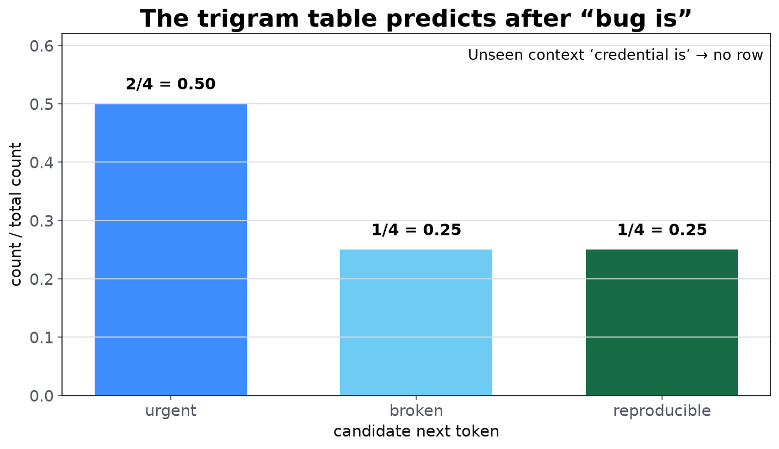
EXECUTABLE WORKED EXAMPLE
Counts become next-token probabilities
01 DECIDE
One label
02 PREDICT
One neuron
03 LEARN
One update
04 BATCH
Many examples
05 LANGUAGE
Next token
06 BRIDGE
Transformer
A trigram is a classifier keyed by two exact context tokens.
context
('bug', 'is')
counts
urgent: 2
reproducible: 1
broken: 1
P(next)
0.50 / 0.25 / 0.25
04_ngram_language_model.py generates 10 training rows and returns no row for an unseen context.
LLMs FROM FIRST PRINCIPLES • CLASS 2
36
Notes:
Timing: 2:47–2:50
Purpose: Make the n-gram estimate reproducible and show exactly what happens for an unseen context.
Talk track:
Run the script, inspect the Counter for bug is, and divide each count by four. Then query credential is. The empty result is not a software bug; it is the model's exact-context limitation.
Transition:
Name the representation failures that motivate learned features.
[Sources]
- Course-created fictional BugBoard examples and numerical values; not production or WHOOP data.
- Daniel Jurafsky and James H. Martin, Speech and Language Processing, 3rd edition draft — https://web.stanford.edu/~jurafsky/slp3/
[/Sources]

Slide 37
WHY N-GRAMS STOP SCALING
A longer fixed window creates a larger sparsity problem
01 DECIDE
One label
02 PREDICT
One neuron
03 LEARN
One update
04 BATCH
Many examples
05 LANGUAGE
Next token
06 BRIDGE
Transformer
Fixed context
Exact combinations
Exploding table
Relevant information outside the chosen window is invisible to the prediction.
Similar meanings do not automatically share evidence across different token sequences.
Possible contexts grow combinatorially with vocabulary size and window length.
LLMs FROM FIRST PRINCIPLES • CLASS 2
37
Notes:
Timing: 2:50–2:54
Purpose: Create the exact representation problem that the transformer section must solve.
Talk track:
Increasing n can capture longer patterns but sharply reduces repeated exact contexts. The model must share statistical structure and select relevant information without storing every possible token combination independently.
Transition:
Replace the fixed lookup with learned vectors before handing off to attention.
[Sources]
- Daniel Jurafsky and James H. Martin, Speech and Language Processing, 3rd edition draft — https://web.stanford.edu/~jurafsky/slp3/
[/Sources]

Slide 38
NEURAL N-GRAM
Learn the context representation and the token scores
01 DECIDE
One label
02 PREDICT
One neuron
03 LEARN
One update
04 BATCH
Many examples
05 LANGUAGE
Next token
06 BRIDGE
Transformer
TOKEN IDS
discrete inputs
EMBEDDINGS
learned vectors
CONTEXT
combined features
LM HEAD
vocabulary logits
SOFTMAX
next-token probabilities
→
→
→
→
The loss-gradient-update loop now changes both the context representation and the output scores.
LLMs FROM FIRST PRINCIPLES • CLASS 2
38
Notes:
Timing: 2:54–2:56
Purpose: Bridge from count tables to learned next-token prediction.
Talk track:
A neural n-gram model can share information through embeddings and learned layers, but the selected context positions remain fixed in advance. The final language-model head is still a multiclass linear layer over the vocabulary.
Transition:
Train that small model and compare its output with the count table.
[Sources]
- Daniel Jurafsky and James H. Martin, Speech and Language Processing, 3rd edition draft — https://web.stanford.edu/~jurafsky/slp3/
- Ian Goodfellow, Yoshua Bengio, and Aaron Courville, Deep Learning — https://www.deeplearningbook.org/
[/Sources]

Slide 39
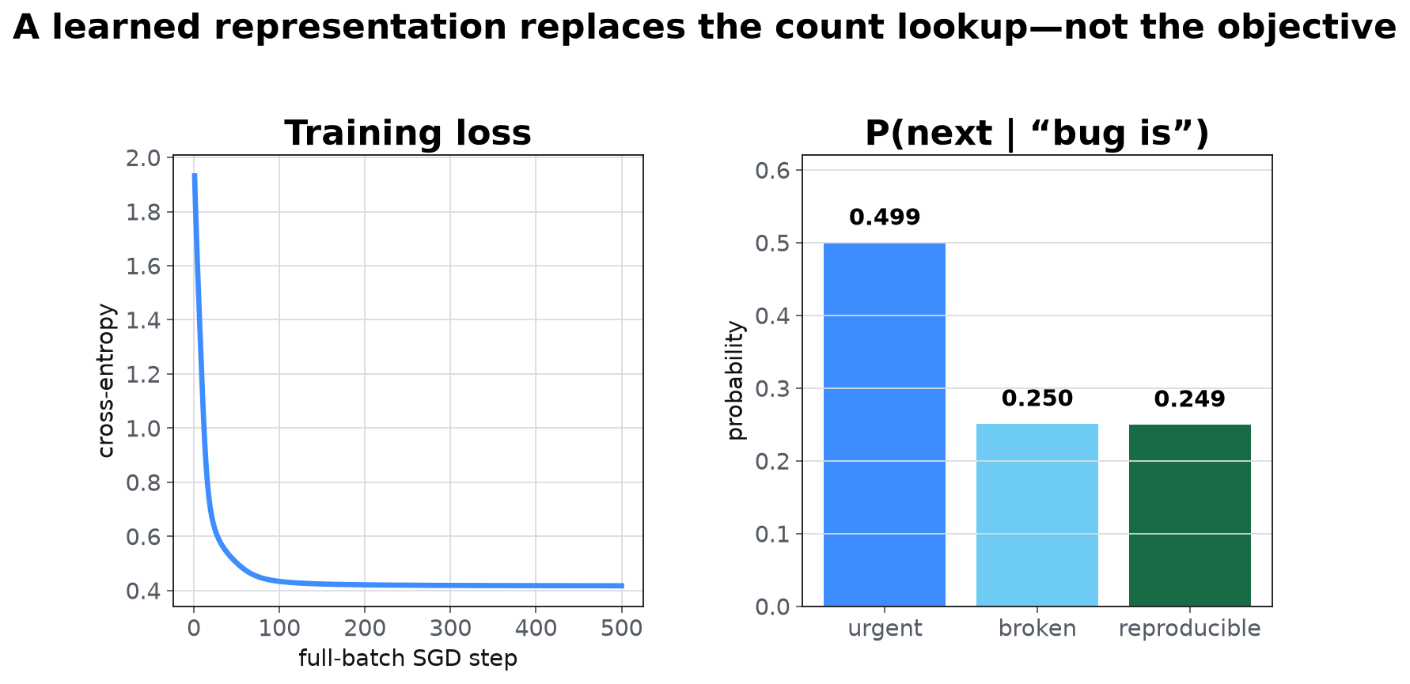
EXECUTABLE WORKED EXAMPLE
Learned context uses the same prediction objective
01 DECIDE
One label
02 PREDICT
One neuron
03 LEARN
One update
04 BATCH
Many examples
05 LANGUAGE
Next token
06 BRIDGE
Transformer
Embeddings change how context is represented; softmax still predicts the next token.
examples = 10
embedding = [7, 4]
LM head = [8, 7]
loss
1.932 → 0.417
P(urgent | bug is)
0.499
05_neural_ngram.py implements the embedding and output-layer gradients manually in NumPy.
LLMs FROM FIRST PRINCIPLES • CLASS 2
39
Notes:
Timing: 2:56–2:58
Purpose: Demonstrate that learned context features use the same classification loss and gradient loop.
Talk track:
The model has seven token embeddings and one eight-by-seven output matrix. Full-batch SGD reduces the loss from about 1.93 to 0.42 and learns the empirical half, quarter, quarter continuation pattern for bug is.
Transition:
State what a transformer changes beyond this fixed-context learned model.
[Sources]
- Course-created fictional BugBoard examples and numerical values; not production or WHOOP data.
- Daniel Jurafsky and James H. Martin, Speech and Language Processing, 3rd edition draft — https://web.stanford.edu/~jurafsky/slp3/
- Ian Goodfellow, Yoshua Bengio, and Aaron Courville, Deep Learning — https://www.deeplearningbook.org/
[/Sources]

Slide 40
CLASS 3 HANDOFF
A transformer is a better way to construct the classifier input
ONE NEURON
One yes/no score
OUTPUT LAYER
One score per class
N-GRAM LM
Next token from fixed context
TRANSFORMER
Next token from learned context
→
→
→
The prediction problem stays next-token classification. Attention makes the useful context depend on the current input.
LLMs FROM FIRST PRINCIPLES • CLASS 2
40
Notes:
Timing: 2:58–2:59
Purpose: Resolve the n-gram limitation without prematurely teaching the entire transformer.
Talk track:
The transformer adds token embeddings, position, attention, residual paths, normalization, feed-forward layers, and repeated blocks. Its output remains vocabulary logits followed by a next-token distribution. Class 3 will open the representation box and trace those components.
Transition:
Hand students the implementation path that preserves this ladder.
[Sources]
- Daniel Jurafsky and James H. Martin, Speech and Language Processing, 3rd edition draft — https://web.stanford.edu/~jurafsky/slp3/
- Ashish Vaswani et al., Attention Is All You Need — https://arxiv.org/abs/1706.03762
[/Sources]

Slide 41
HOMEWORK
Build the ladder in three tested stages
01 DECIDE
One label
02 PREDICT
One neuron
03 LEARN
One update
04 BATCH
Many examples
05 LANGUAGE
Next token
06 BRIDGE
Transformer
# A. one binary neuron
score → sigmoid → BCE → gradients → SGD
# B. many output classes
batch logits → stable softmax → cross-entropy
# C. tiny language model
context/label pairs → n-gram counts → shifted labels
Submit code, tests, a finite-difference check, and one causal training trace.
LLMs FROM FIRST PRINCIPLES • CLASS 2
41
Notes:
Timing: 2:59–3:00
Purpose: Convert the conceptual ladder into a cumulative implementation assignment.
Talk track:
The required path is intentionally small enough to run locally. The artifact should explain what changed in the model, why the loss changed, and what a lower training loss does not prove about production behavior.
Transition:
Close with three retrieval prompts.
[Sources]
- User-provided curriculum direction and course design discussion, August 2026.
[/Sources]

Slide 42
EXIT TICKET
One slope scales into an entire model
Prediction → loss → derivative → update
Name what changes at each rung: one neuron, batch, multiclass output, n-gram language model, transformer.
LLMs FROM FIRST PRINCIPLES • CLASS 2
42
Notes:
Timing: 3:00
Purpose: Collect retrieval evidence and close the conceptual loop.
Talk track:
Ask participants to state three things: what the derivative measures, what changes when one neuron becomes a multiclass layer, and what the transformer changes relative to an n-gram model. The desired final sentence is that the transformer improves context construction while retaining next-token classification and gradient-based learning.
Ask / teaching move:
What does the transformer change—and what remains exactly the same?
[Sources]
- User-provided curriculum direction and course design discussion, August 2026.
- Ian Goodfellow, Yoshua Bengio, and Aaron Courville, Deep Learning — https://www.deeplearningbook.org/
- Daniel Jurafsky and James H. Martin, Speech and Language Processing, 3rd edition draft — https://web.stanford.edu/~jurafsky/slp3/
- Ashish Vaswani et al., Attention Is All You Need — https://arxiv.org/abs/1706.03762
[/Sources]

